Slide 1

The General Linear Model
Christophe Phillips
Cyclotron Research Centre
University of Liège, Belgium
SPM Short Course
London, May 2011

Slide 2
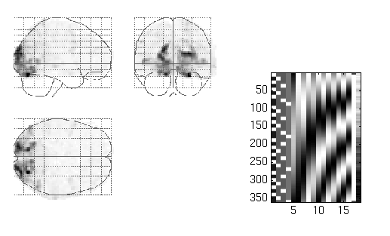
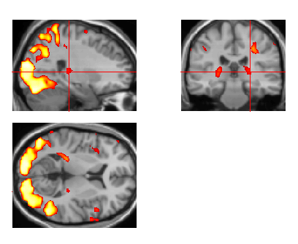
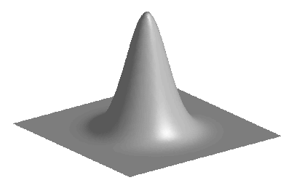
Image time-series
Spatial filter
Design matrix
Statistical Parametric Map
Realignment
Smoothing
General Linear Model
Statistical Inference
RFT
Normalisation
Anatomical reference
p <0.05
Parameter estimates

Slide 3
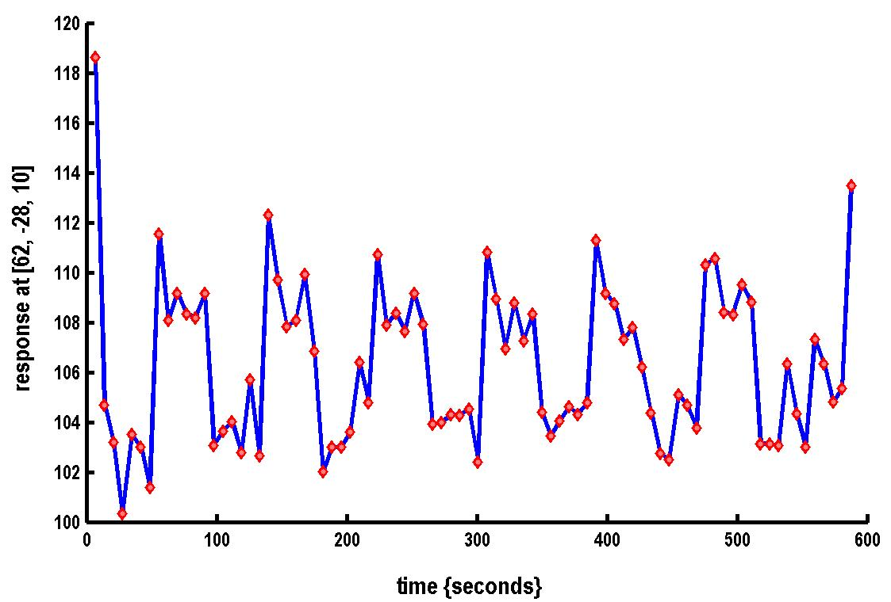

A very simple fMRI experiment
One session
Passive word listening
versus rest
7 cycles of
rest and listening
Blocks of 6 scans
with 7 sec TR
Stimulus function
Question: Is there a change in the BOLD response between listening and rest?

Slide 4
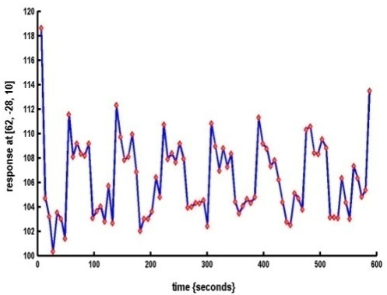

Modelling the measured data
Why?
Make inferences about effects of interest
How?
Decompose data into effects and error
Form statistic using estimates of effects and error
stimulus function
effects estimate
linear
model
statistic
data
error estimate

Slide 5
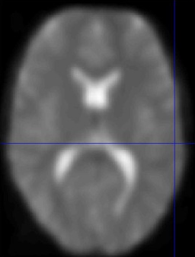
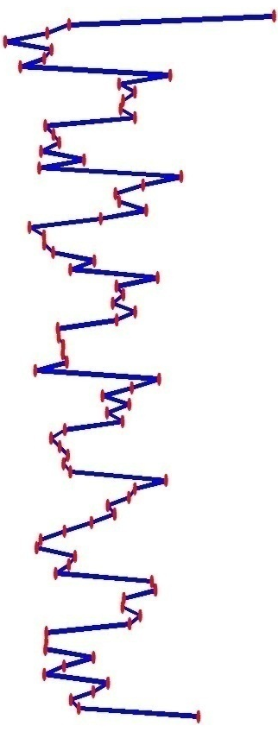
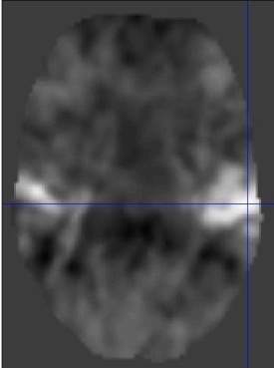
Voxel-wise time series analysis
Model
specification
Parameter
estimation
Time
Hypothesis
Statistic
Time
BOLD signal
single voxel
time series
SPM

Slide 6

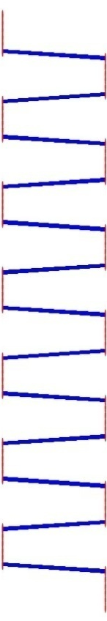
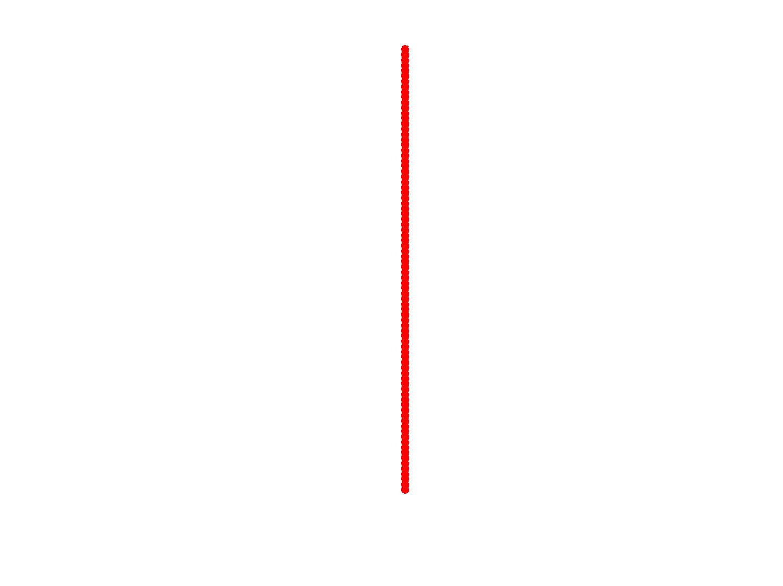
Single voxel regression model
error
=
β₁
+
β₂
+
Time
x₁
x₂
e
BOLD signal

Slide 7
Mass-univariate analysis: voxel-wise GLM
X
y
+
=
Model is specified by both
Design matrix X
Assumptions about e
N: number of scans
p: number of regressors
The design matrix embodies all available knowledge about experimentally controlled factors and potential confounds.

Slide 8
GLM: mass-univariate parametric analysis
one sample t-test
two sample t-test
paired t-test
Analysis of Variance (ANOVA)
Factorial designs
correlation
linear regression
multiple regression
F-tests
fMRI time series models
Etc..

Slide 9



Parameter estimation
Objective:
estimate parameters to minimize
=
+
y
X
Ordinary least squares estimation (OLS) (assuming i.i.d. error):

Slide 10
A geometric perspective on the GLM
Smallest errors (shortest error vector)
when e is orthogonal to X
y
e
x₂
x₁
Design space defined by X
Ordinary Least Squares (OLS)

Slide 11
Correlated and orthogonal regressors
y
x₂
x₂*
x₁
When x₂ is orthogonalized w.r.t. x₁, only the parameter estimate for x₁ changes, not that for x₂!
Correlated regressors =
explained variance is shared between regressors

Slide 12
What are the problems of this model?
=
+
y
X

Slide 13
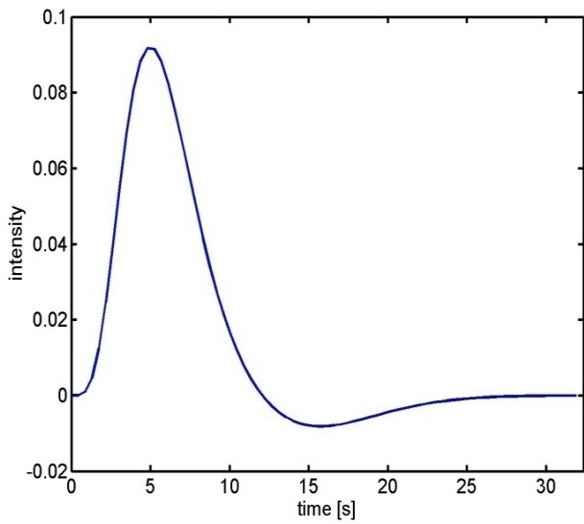
What are the problems of this model?
BOLD responses have a delayed and dispersed form.
HRF
The BOLD signal includes substantial amounts of low-frequency noise (eg due to scanner drift).
Due to breathing, heartbeat & unmodeled neuronal activity, the errors are serially correlated. This violates the i.i.d. assumptions of the noise model in the GLM

Slide 14
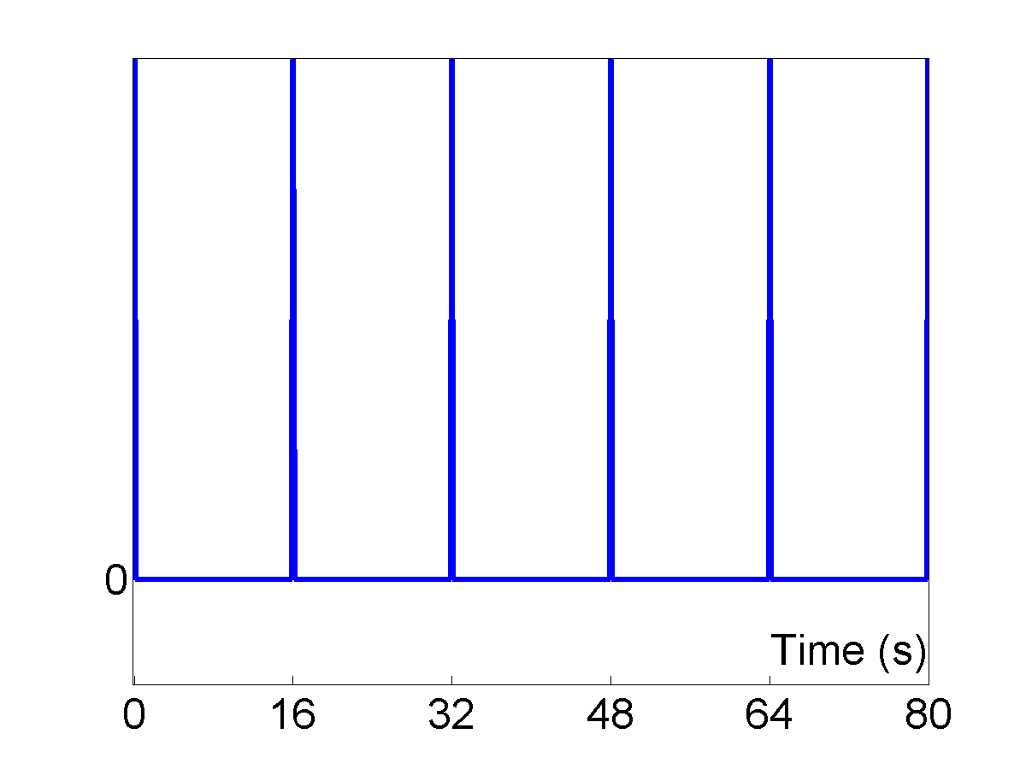
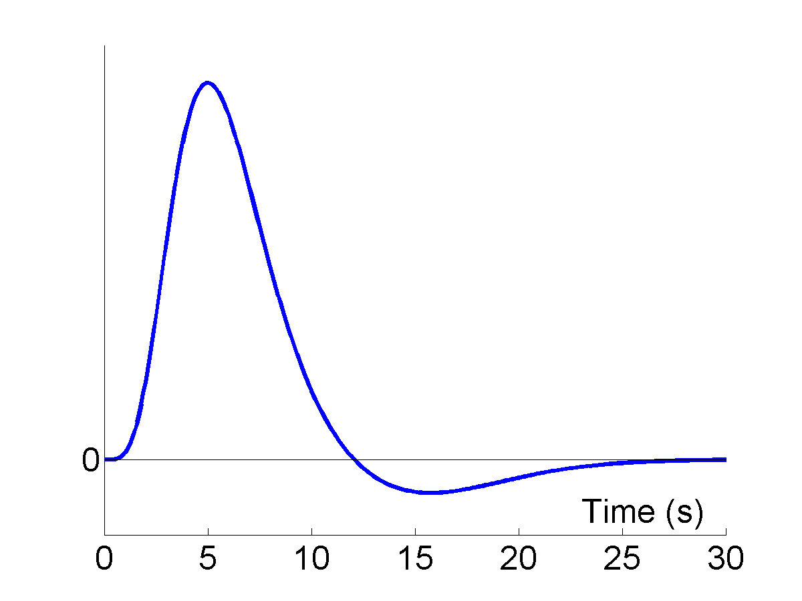
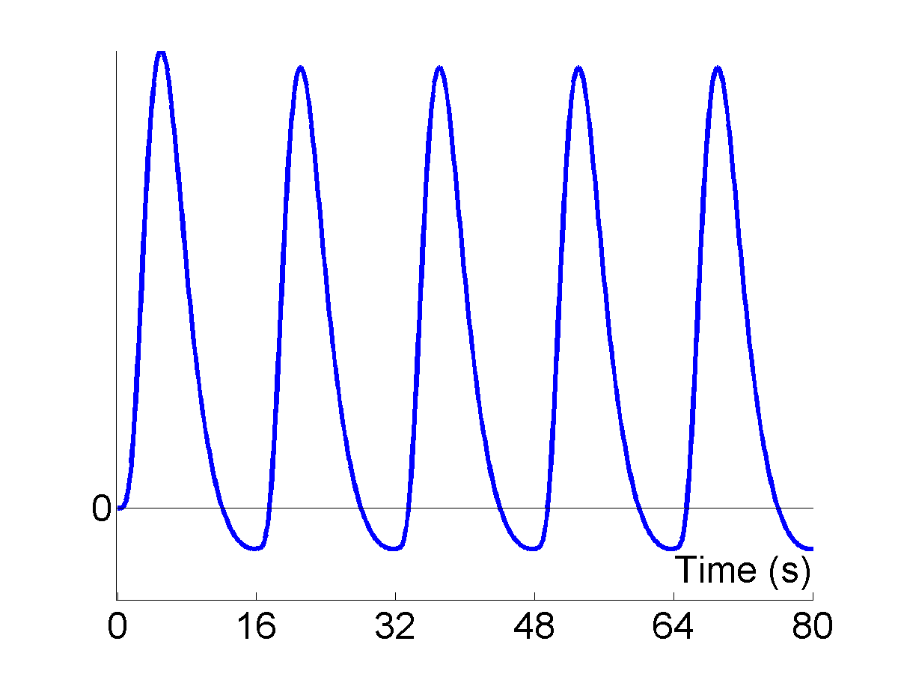
Problem 1: Shape of BOLD response Solution: Convolution model
Impulses
HRF
Expected BOLD
⊗
=
expected BOLD response
= input function ⊗ impulse response function (HRF)

Slide 15
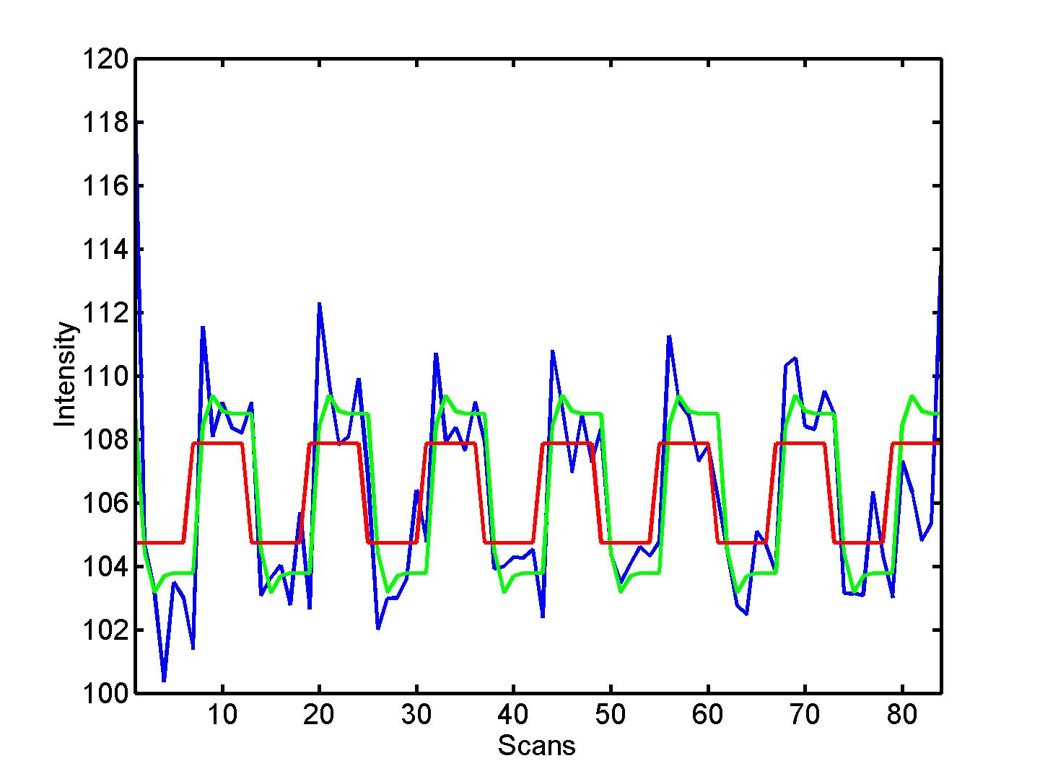


Convolution model of the BOLD response
Convolve stimulus function with a canonical hemodynamic response function (HRF):
⊗ HRF

Slide 16
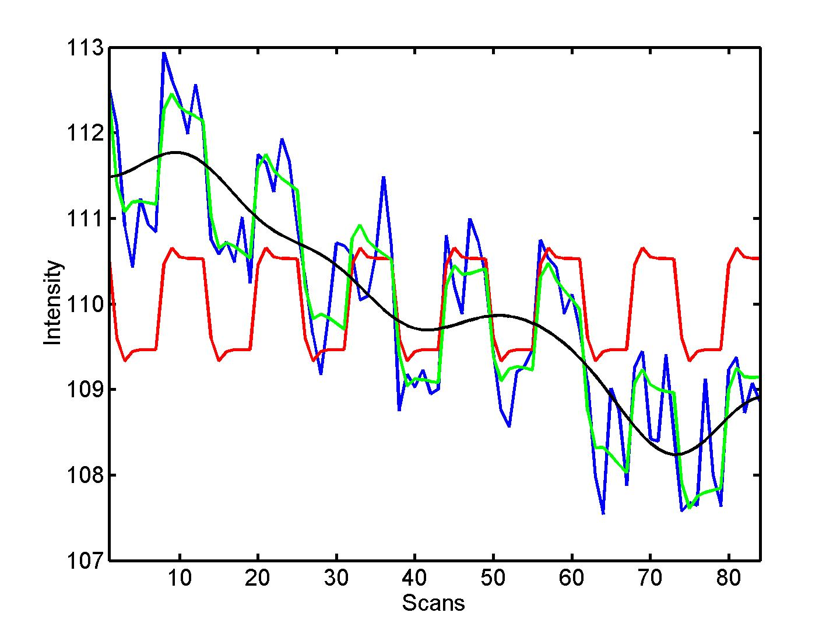
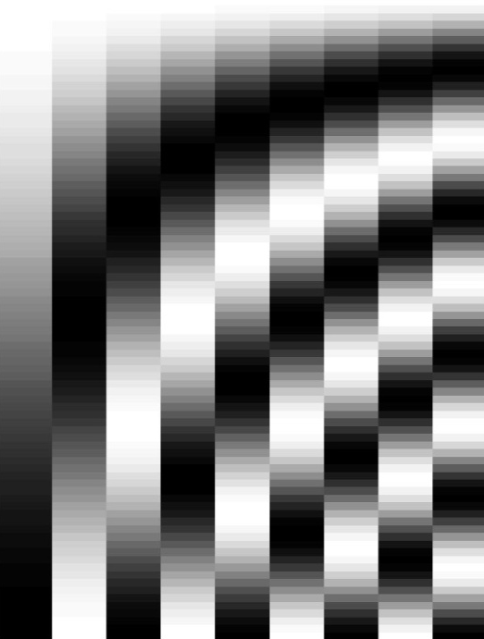
Problem 2: Low-frequency noise Solution: High pass filtering
blue = data
black = mean + low-frequency drift
green = predicted response, taking into account low-frequency drift
red = predicted response, NOT taking into account low-frequency drift
discrete cosine transform (DCT) set

Slide 17
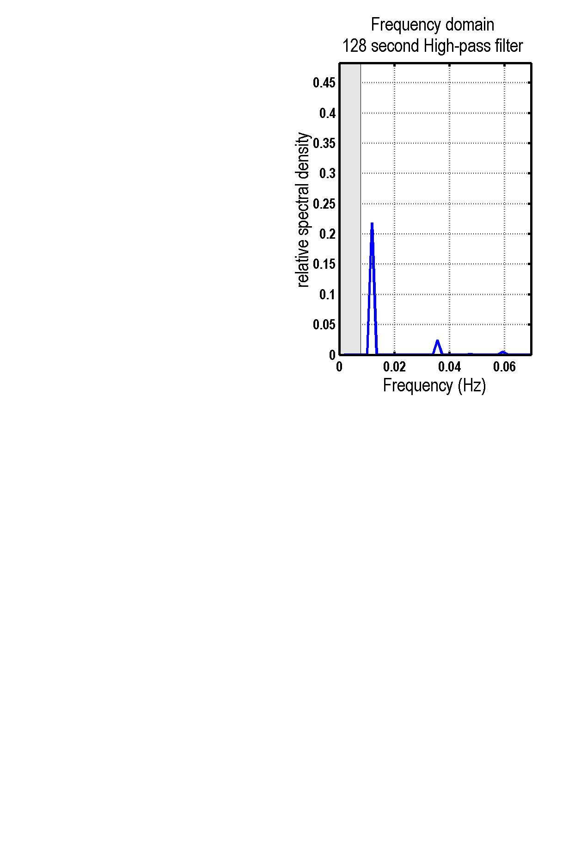

High pass filtering
discrete cosine transform (DCT) set

Slide 18
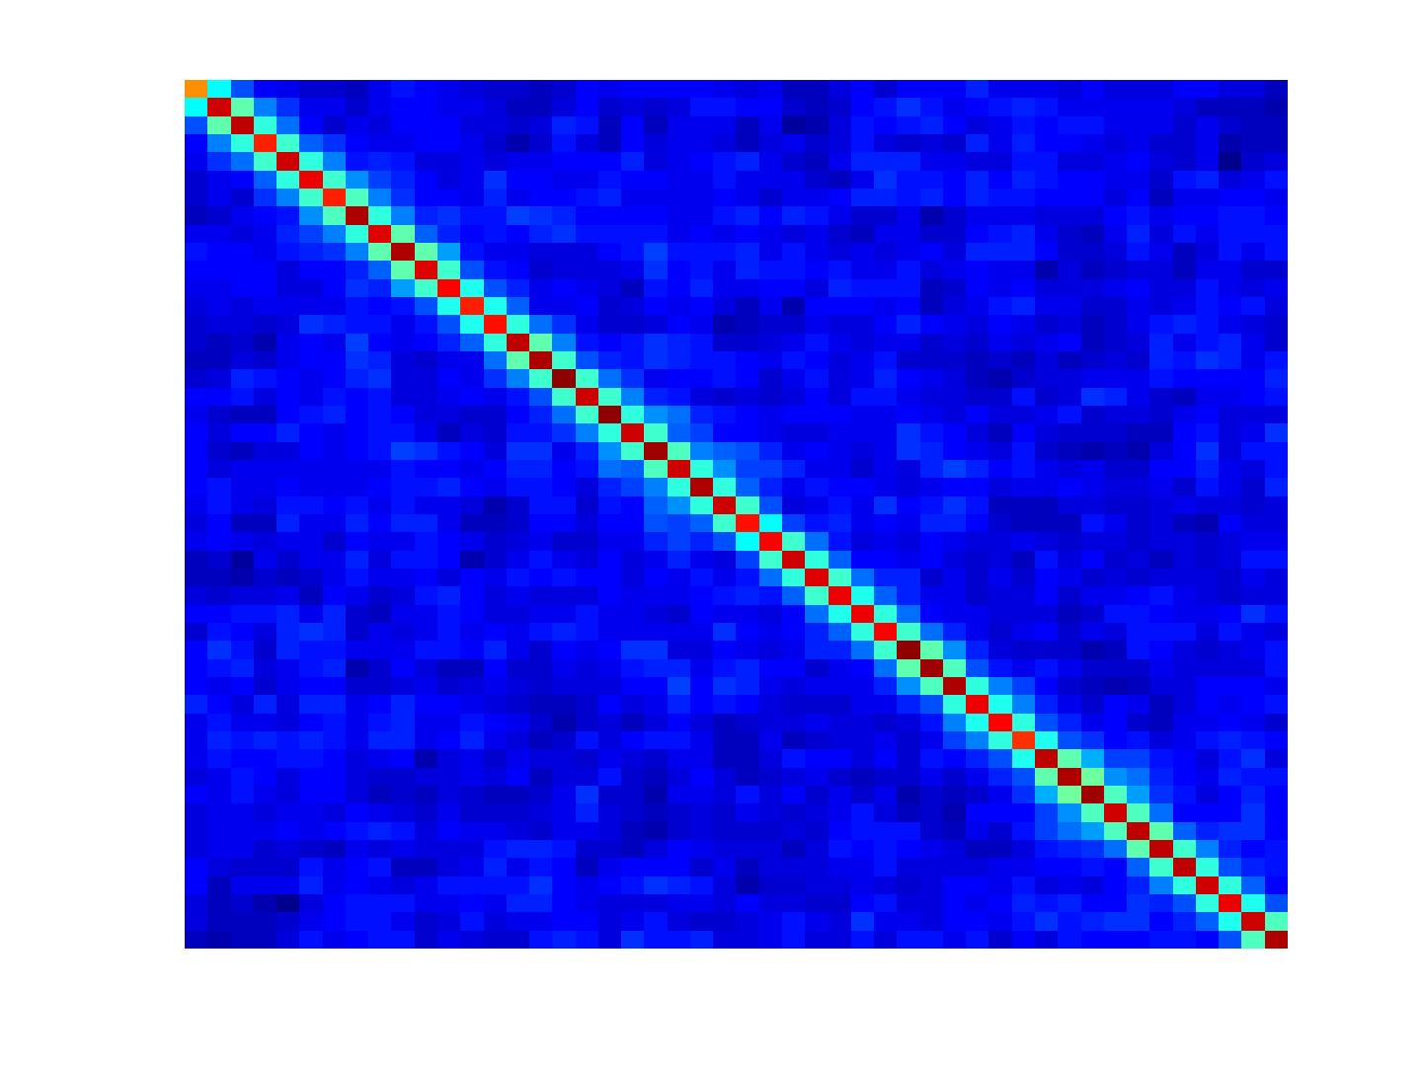
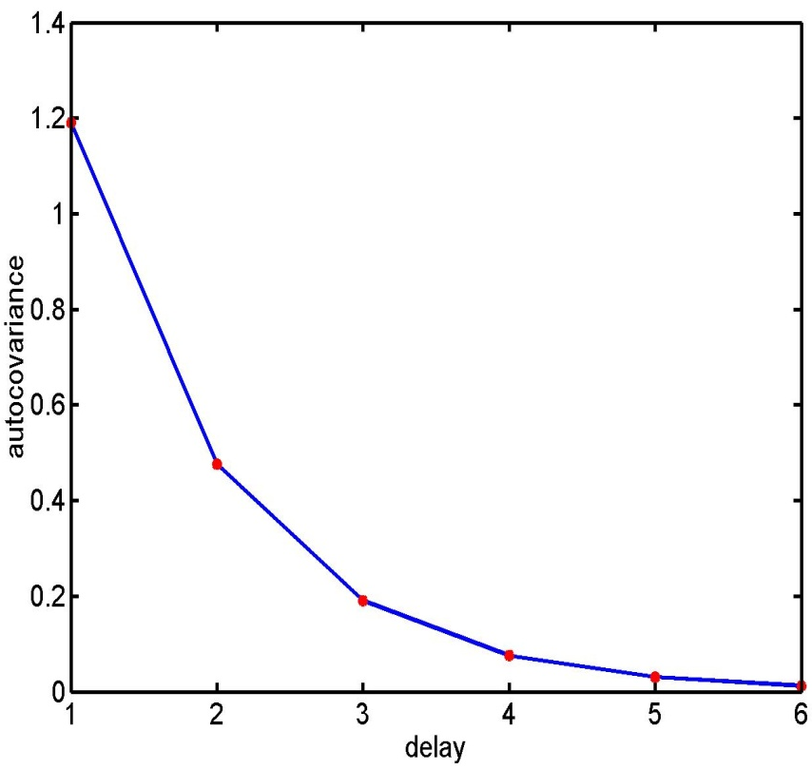
Problem 3: Serial correlations
with
1st order autoregressive process: AR(1)
autocovariance
function

Slide 19
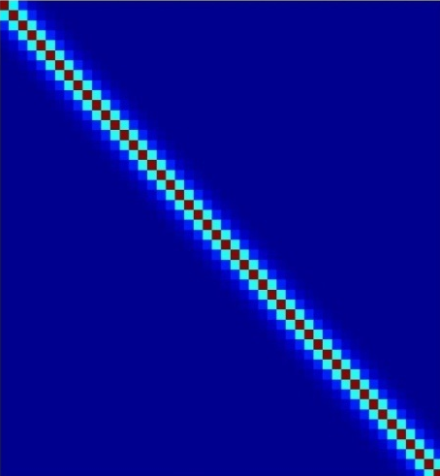
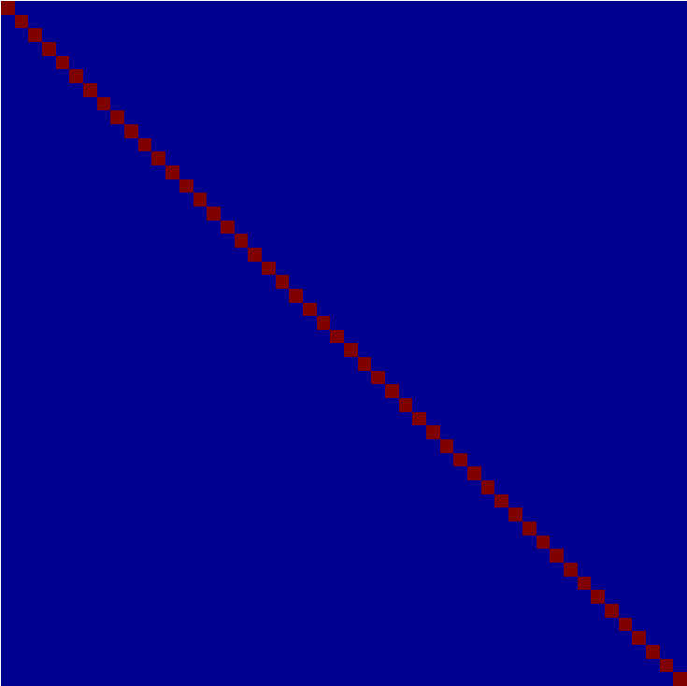
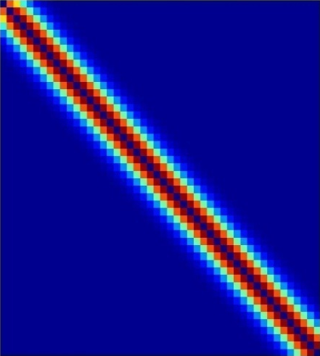
Multiple covariance components
enhanced noise model at voxel i
error covariance components Q
and hyperparameters λ
V
Q₁
Q₂
=
λ₁
+ λ₂
Estimation of hyperparameters λ with ReML (Restricted Maximum Likelihood).

Slide 20
Parameters can then be estimated using Weighted Least Squares (WLS)
Let
Then
WLS equivalent to
OLS on whitened
data and design
where

Slide 21
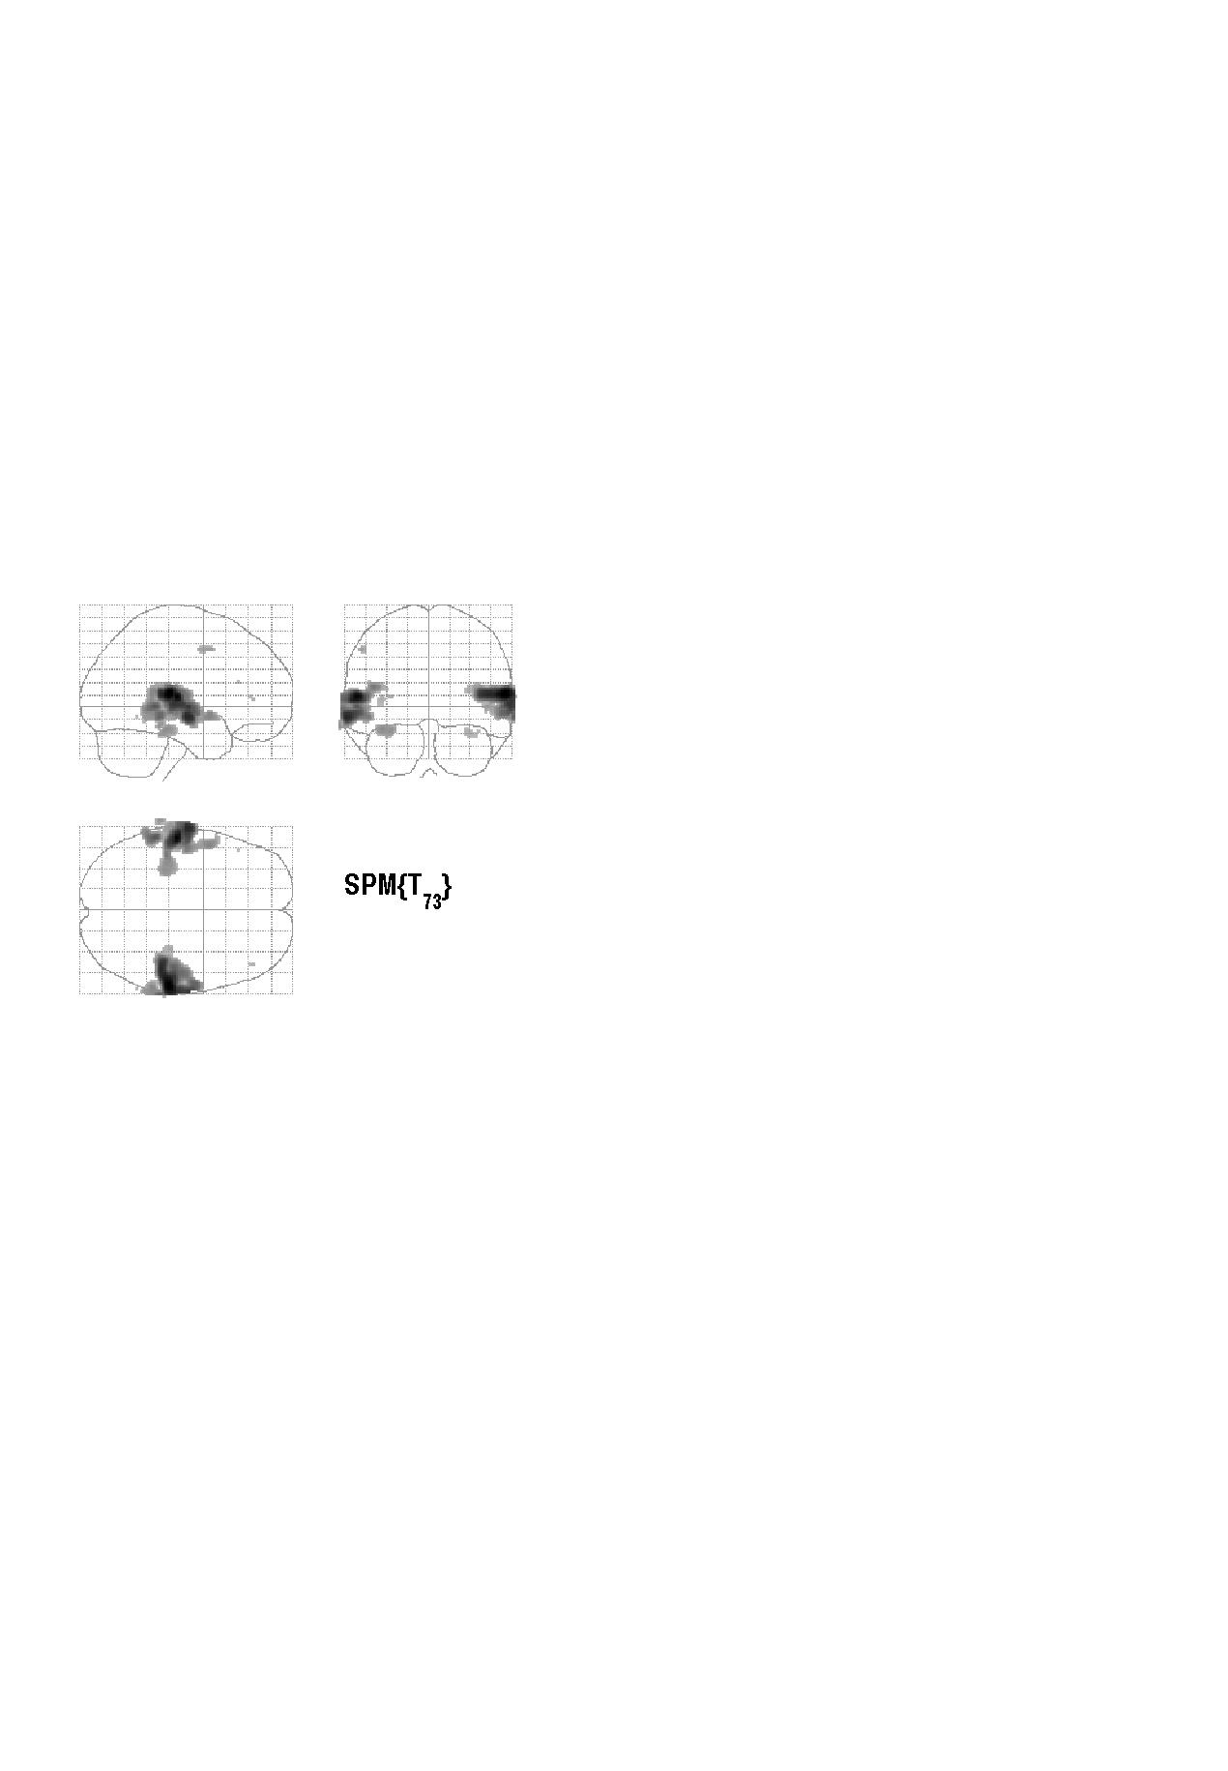

Contrasts & statistical parametric maps
c = 1 0 0 0 0 0 0 0 0 0 0
Q: activation during listening ?
Null hypothesis:

Slide 22
Summary
Mass univariate approach.
Fit GLMs with design matrix, X, to data at different points in space to estimate local effect sizes,
GLM is a very general approach
Hemodynamic Response Function
High pass filtering
Temporal autocorrelation

Slide 23
Thank you for your attention!
…and thanks to Guillaume for his slides ☺.

